Slide 1
Submitted From:
MD Dulal Hossain
ID : 213902116
Section : 213 D_5
Course Code : CSE 316
Title : Desktop Voice Assistant .
Submitted To :
Sagufta Sabah Nakshi
Lecturer,
Department of CSE, GUB.

Slide 2




Outline
Introduction
Implementation
Overview
Objectives
Project Details
Workflow
Source Code
Chapter 1
Chapter 2
Performance
Chapter 3
Chapter 4
Conclusion
Results Analysis
Testing
Discussion
Limitations
Future Work
References

Slide 3
Outline
Introduction
Implementation
Overview
Objectives
Project Details
Workflow
Source Code
Chapter 1
Chapter 2
Performance
Chapter 3
Chapter 4
Conclusion
Results Analysis
Testing
Discussion
Limitations
Future Work
References

Slide 4
Outline
Introduction
Implementation
Overview
Objectives
Project Details
Workflow
Source Code
Chapter 1
Chapter 2
Performance
Chapter 3
Chapter 4
Conclusion
Results Analysis
Testing
Discussion
Limitations
Future Work
References

Slide 5
Outline
Introduction
Implementation
Overview
Objectives
Project Details
Workflow
Source Code
Chapter 1
Chapter 2
Performance
Chapter 3
Chapter 4
Conclusion
Results Analysis
Testing
Discussion
Limitations
Future Work
References

Slide 6
Outline
Introduction
Implementation
Overview
Objectives
Project Details
Workflow
Source Code
Chapter 1
Chapter 2
Performance
Chapter 3
Chapter 4
Conclusion
Results Analysis
Testing
Discussion
Limitations
Future Work
References

Slide 7
Outline
Introduction
Implementation
Overview
Objectives
Project Details
Workflow
Source Code
Chapter 1
Chapter 2
Performance
Chapter 3
Chapter 4
Conclusion
Results Analysis
Testing
Discussion
Limitations
Future Work
References

Slide 8
Introduction
Overview
Objective
MD Dulal Hossain's Desktop Voice Assistant from Green University of Bangladesh uses Tkinter for a GUI, allowing typed or voice commands. It provides time, plays music, gives weather updates, and opens websites, with text-to-speech responses, enhancing user convenience, productivity, and accessibility.
The Desktop Voice Assistant project leverages AI and natural language processing to simplify tasks via voice commands, inspired by virtual assistants like Siri and Alexa. It enhances desktop accessibility by integrating speech recognition and text-to-speech for intuitive task performance, showcasing practical AI application and the developer's skills.

Slide 9
Implementation
Project Details
Workflow
This project follows a streamlined workflow: it greets users, listens for commands, executes actions (like weather updates, opening websites, playing music), handles conversations with AI, manages errors, allows termination commands, and logs events for debugging.
MD Dulal Hossain's Desktop Voice Assistant from Green University of Bangladesh enhances human-computer interaction using Tkinter GUI, voice, and text commands. It performs tasks like weather updates, internet browsing, music playback, and system functions. Featuring speech recognition, pyttsx3 for responses, and web scraping, it offers a versatile, user-friendly tool.
Source Code
Explain this parts for better understand.

Slide 10

Source Code
Step 6
Step 2
Step 5
Step 4
Step 3
Step 1

Slide 11
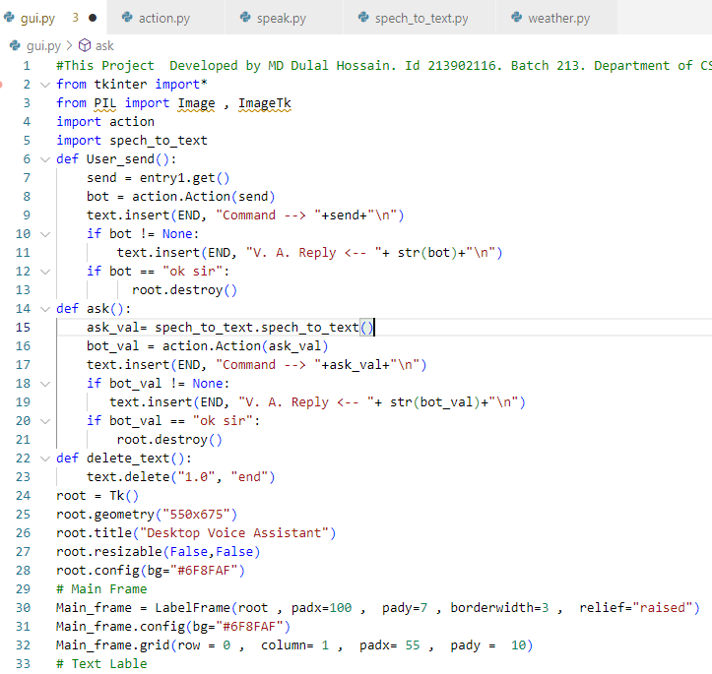
Graphical User Interface (GUI) part 1
Step 6
Step 4
Step 2
Step 5
Step 3
Step 1
Figure 2.1: Graphical User Interface (GUI) part 1.

Slide 12
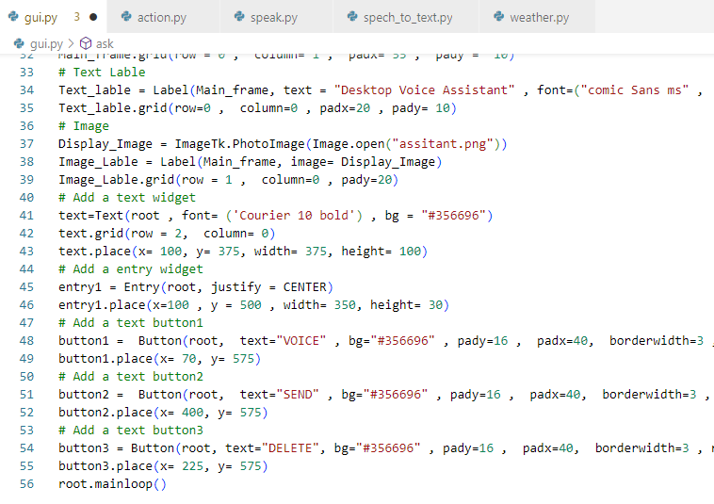
Graphical User Interface (GUI) part 2
Step 6
Step 2
Step 5
Step 4
Step 3
Step 1
Figure 2.2: Graphical User Interface (GUI) part 2.

Slide 13
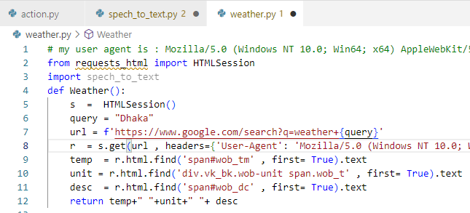
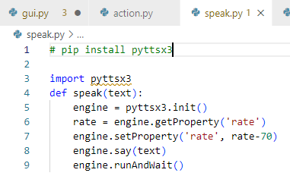
Speak Part & Weather
Step 6
Step 2
Step 5
Step 4
Step 3
Step 1
Figure 2.3: Speak Part & Weather .

Slide 14
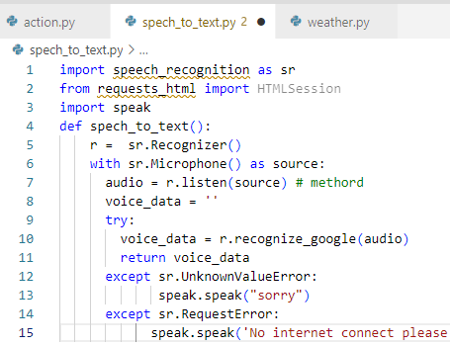
Speech to text
Step 6
Step 2
Step 5
Step 4
Step 3
Step 1
Figure 2.4: Speech to text.

Slide 15
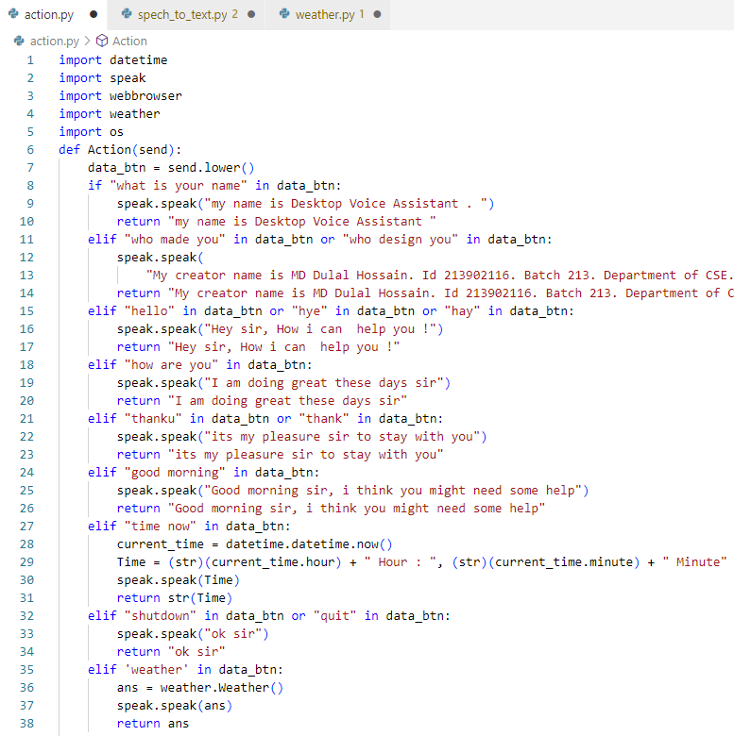
Action part 1
Step 6
Step 5
Step 2
Step 4
Step 3
Step 1
Figure 2.5: Action part 1.

Slide 16
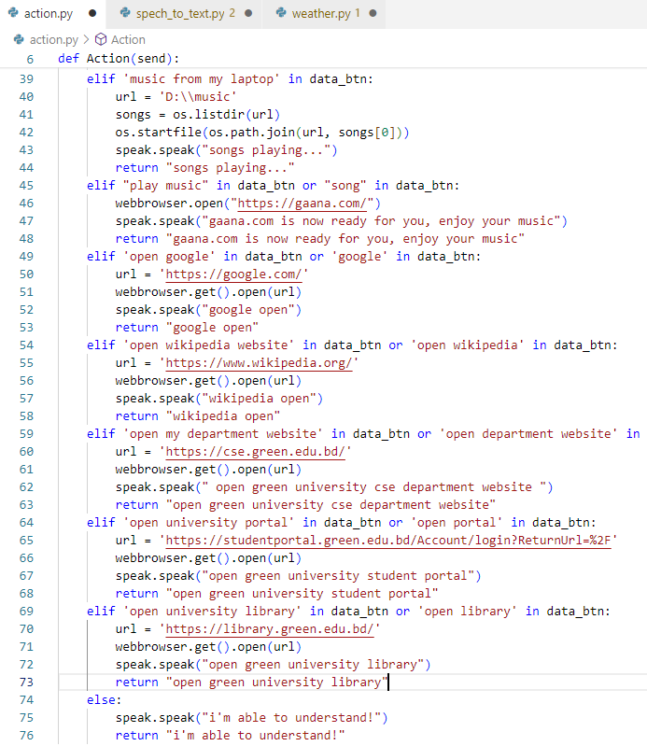
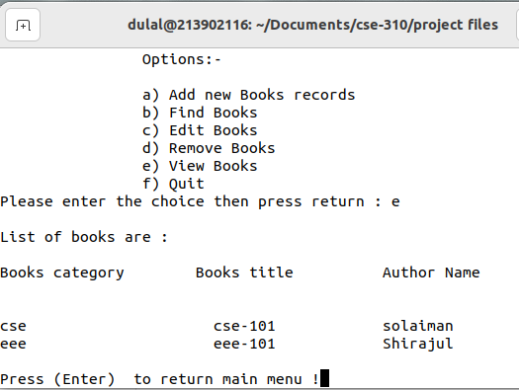
Action part 2
View& Quit
Step 2
Step 6
Step 5
Step 4
Step 23
Step 1
Figure 3.6: View-Books.
Figure 2.6: Action part 2.

Slide 17
Performance
Result Analysis
Testing
The project integrates Tkinter for a user-friendly GUI, Speech Recognition for voice input, and executes various commands effectively. Basic error handling is present, but improvements are needed for smoother operation. Modular integration allows for easy maintenance and enhancements.
MD Dulal Hossain's desktop voice assistant integrates GUI, speech recognition, and functional actions effectively, offering a user-friendly interface for manual and voice interactions. While executing various commands, improvements in error handling, functionality expansion, and user experience refinement are suggested.

Slide 18
Testing
Step 6
Step 2
Step 5
Step 4
Step 3
Step 1

Slide 19
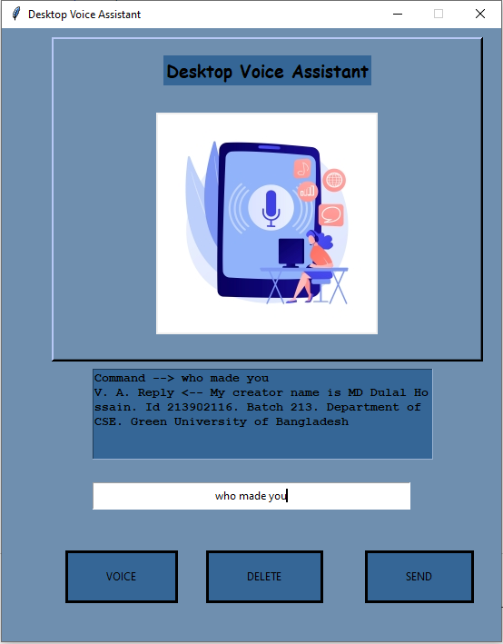
Who Design You
Step 6
Step 4
Step 2
Step 5
Step 3
Step 1
Figure 3.1: Who Design You.

Slide 20
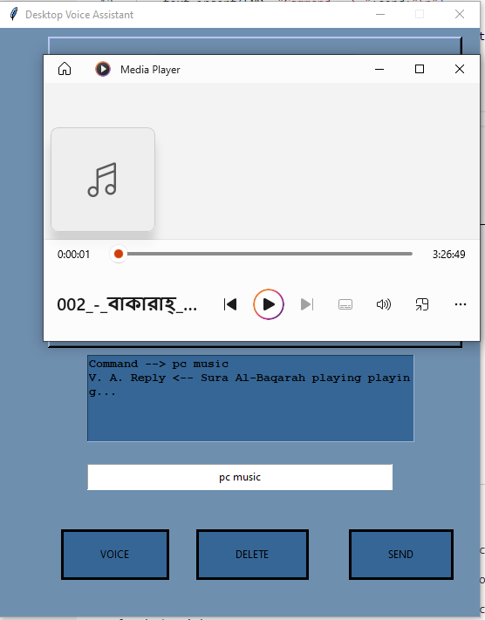
music from my pc
Step 6
Step 2
Step 5
Step 4
Step 3
Step 1
Figure 3.2: music from my pc .

Slide 21
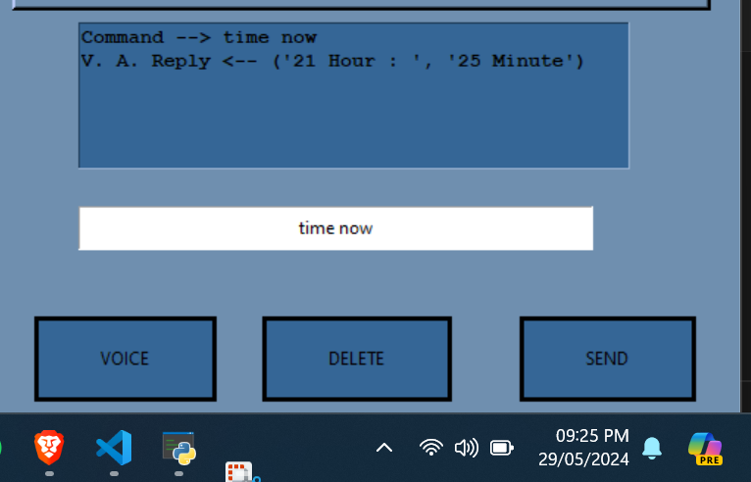
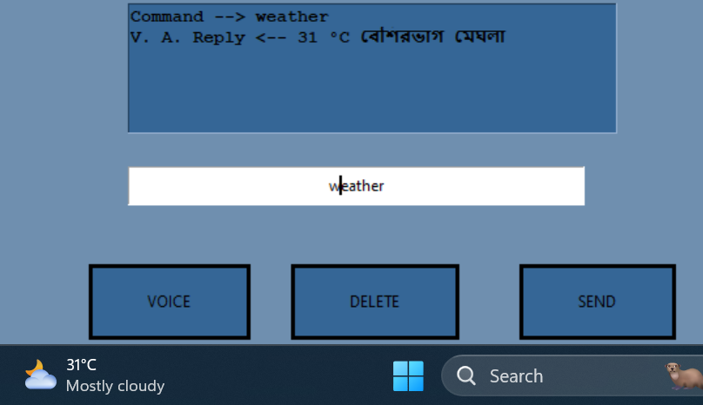
Weather & Time
Step 6
Step 2
Step 5
Step 4
Step 3
Step 1
Figure 3.3: Weather & Time.

Slide 22
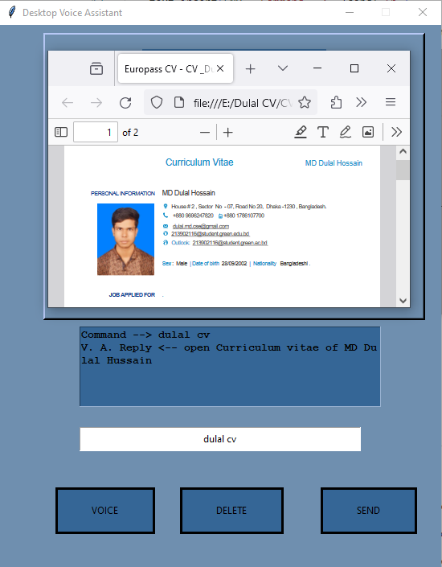
open my cv
Step 6
Step 2
Step 5
Step 4
Step 3
Step 1
Figure 3.4: open my cv .

Slide 23
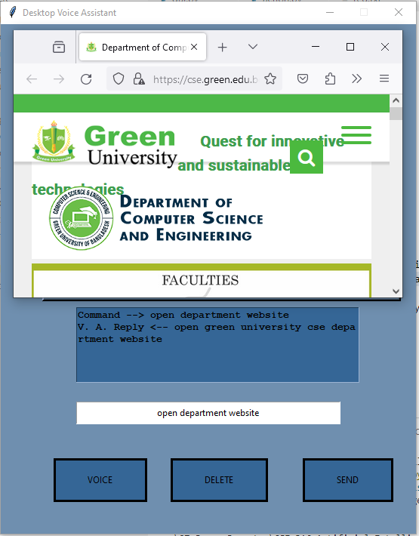
open my department website
Step 6
Step 5
Step 2
Step 4
Step 3
Step 1
Figure 3.5: open my department website .

Slide 24
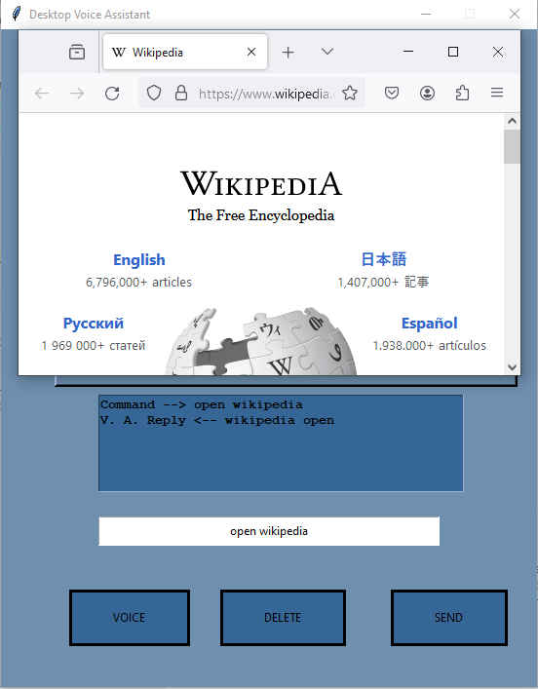
open wikipedia website
View& Quit
Step 2
Step 6
Step 5
Step 4
Step 23
Step 1
Figure 3.6: View-Books.
Figure 3.6: Action part 2.

Slide 25
Conclusion…
Discussion
Limitations
The project showcases a desktop voice assistant with a clean GUI for text and voice interaction. It handles commands like weather updates, music playback, and web browsing. Error handling ensures smooth operation, while future improvements could enhance the GUI aesthetics and user feedback.
The Desktop Voice Assistant's reliance on internet connectivity limits offline use. Speech recognition struggles in noisy environments or with accents. It lacks adaptability to new commands, and the GUI needs refinement for better user experience. Inadequate error handling may cause crashes.

Slide 26
Conclusion
Future Work
References
Improvements include enhancing Natural Language Understanding for better accuracy, integrating machine learning for adaptive learning, introducing intuitive interfaces like gesture recognition, ensuring multi-platform compatibility, expanding functionalities, adding localization, and incorporating accessibility features for disabled users.
https://developers.google.com/edu/python
https://www.udemy.com/course/python-the-complete-python-developer-course/
https://www.learnpython.org/
https://www.geeksforgeeks.org/python-projects-beginner-to-advanced/
https://realpython.com/tutorials/projects/

Slide 27
Thank You
Keep Learning, Keep Grinding

